Slide 1
Digital Portfolio
STUDENT NAME: S.KIRUTHIKA
REGISTER NO AND NMID: 222407498
DEPARTMENT: B.Sc Computer Science
COLLEGE: MAHALASHMI WOMEN`S COLLEGE OF ARTS & SCIENCE

Slide 2
DIGITAL PORTFOLIO

Slide 3


AGENDA
Problem Statement
Project Overview
End Users
Tools and Technologies
Portfolio design and Layout
Features and Functionality
Results and Screenshots
Conclusion
Github Link
3/21/2024 Annual Review

Slide 4

PROBLEM STATEMENT
In today’s digital era, resumes and text-based profiles are not enough to showcase technical skills. Recruiters and clients expect interactive, visually appealing portfolios that highlight skills, projects, and creativity. A static resume fails to demonstrate coding and design ability.

Slide 5

PROJECT OVERVIEW
The Digital Portfolio is a personal website that highlights my skills, projects, and contact details. It allows visitors to view my profile, explore my projects, and connect with me. Designed using HTML, CSS, and JavaScript, it reflects my technical knowledge and design sense.

Slide 6

WHO ARE THE END USERS?
Students → To create their personal brand online.
Recruiters/Employers → To evaluate candidate’s skills and portfolio.
Clients → To check developer expertise before collaboration.
General Audience → To learn more about me and my work.

Slide 7

TOOLS AND TECHNIQUES
HTML → Structure of the portfolio (sections: About, Skills, Projects, Contact).
CSS → Styling, layouts, colors, responsiveness, animations.
JavaScript → Typing effects, navigation interactivity.
GitHub / CodePen → Hosting and sharing portfolio online.

Slide 8
POTFOLIO DESIGN AND LAYOUT
Header Section → Name/logo, navigation bar (About, Skills, Projects, Contact).
Profile Section → Profile photo, introduction, tagline.
Skills Section → Technical expertise listed.
Projects Section → Showcases completed works with links/screenshots.
Contact Section → Email, social links for communication.
Design Style → Clean, responsive, modern dark-theme with animations.
8

Slide 9
FEATURES AND FUNCTIONALITY
Profile introduction with typing animation.
Navigation bar with smooth scrolling.
Responsive design (works on mobile & desktop).
Circular profile picture with stylish border.
Projects showcase with links.
Contact section with email & social media links.

Slide 10
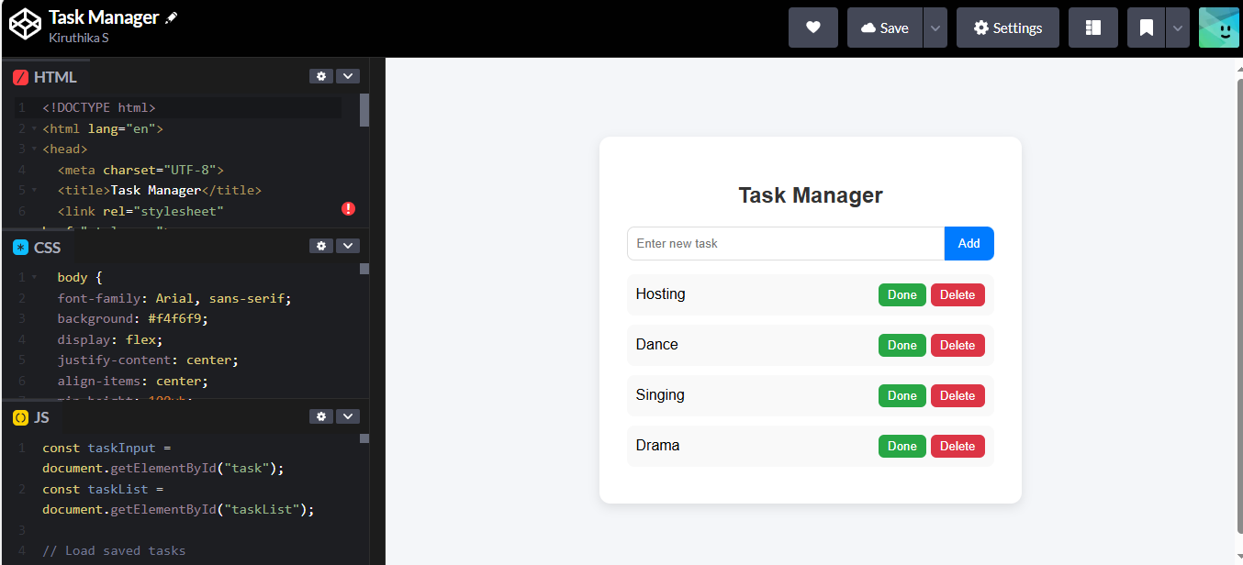

RESULTS AND SCREENSHOTS
3/21/2024 Annual Review
10

Slide 11
CONCLUSION
The Digital Portfolio is an effective way to present skills, projects, and contact details in a professional and interactive format. It enhances personal branding, improves job opportunities, and provides an online presence. Future enhancements may include:
Adding blogs and certifications.
Integrating animations and 3D effects.
Linking live project demos.
11

